Slide 1
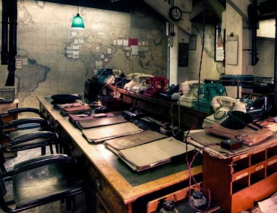
Autumn 2: How did Britain change in World War II?
Text: Winston Churchill’s biography
History: World War II
Science: Everything Changes
RE: Judaism
Trips: Synagogue and Winston Churchill War Rooms
Spring 1: Who are the British?
Text: Holes
History: Who settled in Britain?
Science: Light Up the World
PSCHE: Keeping Safe
Autumn 1: How did Britain change in World War II?
Text: My Uncle’s Dunkirk & The Lion and The Unicorn
History: World War II
Science: Nature Library
PSCHE: Excellent Learners & Self-Esteem
DT: Anderson shelters
Year 6
Summer 2: Why is the landscape shaped like it is?
Text: The Giant’s Necklace and Lucky Dip
Geography: Coastal landscapes and rivers
Science: Electricity
PSCHE: Transition to secondary school
DT: Mobile phone covers
Trip: PGL residential trip
Spring 2: Who are the British?
Text: Holes
History: Who settled in Britain?
Science: Light Up the World
RE: Humanism
Summer 1: Why is the landscape shaped like it is?
Text: The Highwayman
Geography: Coastal landscapes and rivers
Science: Body Pump
PSCHE: Changes (SRE)

