Slide 1
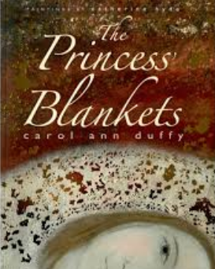
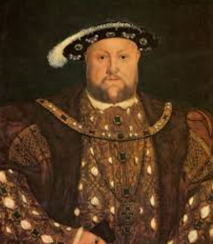
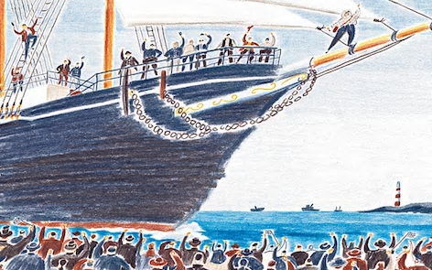
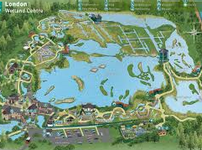
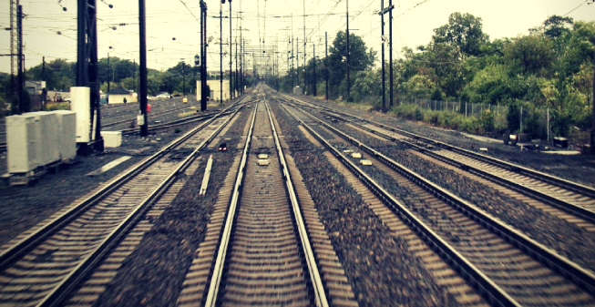
Autumn 2
Text: Princess Blanket and The Iron Man
History: What was life under the ruling of Elizabeth 1?
Science: In a State
RE: Sikhism
DT: Money Containers
Trip: Hampton Court Palace
Spring 1
Text: The Lion the Witch and the Wardrobe and Poetry
Geography: How can we find a village in Ghana?
Science: Good Vibrations
RE: Hinduism
Trip: Visit from George
the Story Teller
Autumn 1
Text: Leon and the Place Between History: What was life like under the rule of Henry VIII?
Science: Where does all the food go?
PSCHE/RE: Self Esteem and Friendship
Year 4
Spring 2
Text: The Story Thief
Geography: Improve quality of life- Ghana
Science: Switched on
PSCHE: Keeping Safe
DT: Lighting Up
Trip: London Wetlands Centre
Summer 2
Text: Shackleton’s Journey
History: What was the effect on the local area from railways?
Science: Human Impact
PSCHE/RE: Changes and SRE
DT: Pop-Up book
Trip: Dulwich College
Summer 1
Text: Street Child
Geography: How could climate change be slowed down
Science: Our Changing World
PSCHE/RE: War and Suffering
Trip: Riverside Waste Authority

