Slide 1
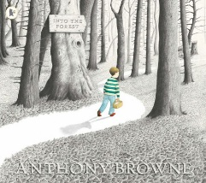
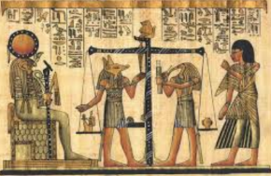
Autumn 2
Text: Hercules and the Rotten Romans
History: How do people decide where to settle?
Science: The Power of Forces
RE: Belief and Belonging
DT: Pizza Making
Spring 1
Text: Fly Eagle, Fly
History: What’s so special about Ancient Egypt?
Science: Rock Detectives
PSHCE: Keeping Ourselves Safe
Trip: The British Museum
Autumn 1
Text: Into the Forest
History: What effect did the Roman invasion have on Britain?
Science: Amazing Bodies
PSCHE: Self-Esteem and Friendship
Trip: Roman Day
Year 3
Spring 2
Text: George Speaks
History: What’s so special about Ancient Egypt?
Science: Rock Detectives
RE: Rights and Respect
DT: Easter Egg Boxes
Summer 2:
Text: Gregory Cool
Geography: How does weather change around the world?
Science: Can you see me?
PSCHE: Changes
DT: Moving Monsters
Summer 1
Text: Krindlekrax
Geography: How does weather change around the world?
Science: How does your garden grow?
RE: Birth ceremonies
Trip: The Science Museum

